Slide 1
Software Engineering
Sobia Iftikhar
Sobia.Iftikhar@nu.edu.pk
Week 03

Slide 2
Content
Agile methods
Agile development techniques
Agile project management
Scaling agile methods
https://www.knowledgehut.com/blog/agile/agile-project-management-vs-traditional-project-management
https://www.youtube.com/watch?v=5RocT_OdQcA

Slide 3
Class 07 22-feb-2021

Slide 4




Agile methods
Plan-driven approaches involve a significant overhead in planning, designing, and documenting the system.
More time is spent on how the system should be developed than on program development and testing. As the system requirements change, rework is essential
Dissatisfaction with heavyweight approaches to software engineering led to the development of agile methods in the late 1990s.

Slide 5
Agile method focus on;
Focus on the code rather than the design
Are based on an iterative approach to software development
Are intended to deliver working software quickly and evolve this quickly to meet changing requirements.

Slide 6
Aim
The aim of agile methods is to reduce overheads in the software process (e.g. by limiting documentation) and to be able to respond quickly to changing requirements without excessive rework.

Slide 7
Agile Manifesto
Individuals and interactions over processes and tools
Working software over comprehensive documentation
Customer collaboration over contract negotiation
Responding to change over following a plan

Slide 8

The principles of agile methods
Customer involvement
Customers should be closely involved throughout the development process. Their role is provide and prioritize new system requirements and to evaluate the iterations of the system.

Slide 9
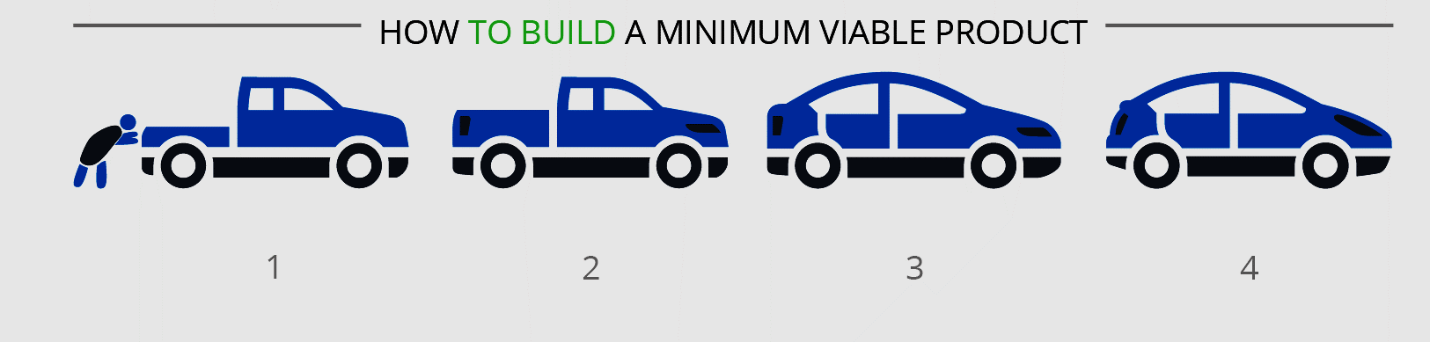
The principles of agile methods
Incremental delivery
The software is developed in increments with the customer specifying the requirements to be included in each increment.
.

Slide 10
The principles of agile methods
People not process
The skills of the development team should be recognized and exploited. Team members should be left to develop their own ways of working without prescriptive processes..
Embrace change
Expect the system requirements to change and so design the system to accommodate these changes.
Maintain simplicity
Focus on simplicity in both the software being developed and in the development process. Wherever possible, actively work to eliminate complexity from the system.

Slide 11
Agile methods have been particularly successful for two kinds of system development.
Product development where a software company is developing a small or medium-sized product for sale.
Custom system development within an organization, where there is a clear commitment from the customer to become involved in the development process

Slide 12
Agile development techniques
Extreme Programming (Xp)
Scrum

Slide 13
Extreme Programming (Xp)
Extreme Programming (XP) takes an ‘extreme’ approach to iterative development.
New versions may be built several times per day;
Increments are delivered to customers every 2 weeks;
All tests must be run for every build and the build is only accepted if tests run successfully.

Slide 14
The extreme programming release cycle

Slide 15
Extreme programming practices
Incremental planning: Requirements are recorded on story cards and the stories to be included in a release are determined by the time available and their relative priority. The developers break these stories into development
Small releases:
The minimal useful set of functionality that provides business value is developed first. Releases of the system are frequent and incrementally add functionality to the first release.
Simple design; Enough design is carried out to meet the current requirements and no more.

Slide 16
Extreme programming practices
Test-first development
An automated unit test framework is used to write tests for a new piece of functionality before that functionality itself is implemented.
Refactoring
All developers are expected to refactor the code continuously as soon as possible code improvements are found. This keeps the code simple and maintainable.
Pair programming
Developers work in pairs, checking each other’s work and providing the support to always do a good job.

Slide 17
Extreme programming practices
Collective ownership
The pairs of developers work on all areas of the system, so that no islands of expertise develop and all the developers take responsibility for all of the code. Anyone can change anything.
Continuous integration
As soon as the work on a task is complete, it is integrated into the whole system. After any such integration, all the unit tests in the system must pass.
Sustainable pace
Large amounts of overtime are not considered acceptable as the net effect is often to reduce code quality and medium term productivity
On-site customer
A representative of the end-user of the system (the customer) should be available full time for the use of the XP team. In an extreme programming process, the customer is a member of the development team and is responsible for bringing system requirements to the team for implementation.

Slide 18
Influential XP practices
Key practices
User stories for specification
Refactoring
Test-first development
Pair programming

Slide 19
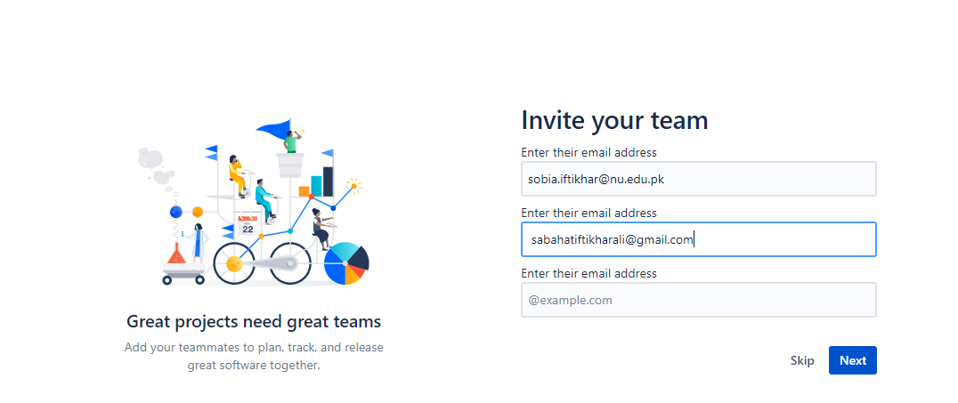
User-Story

Slide 20
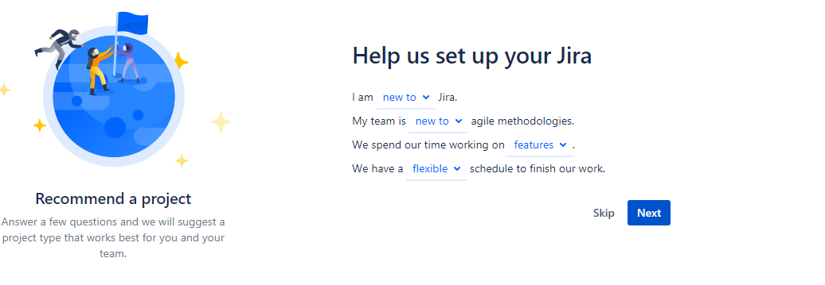
User-Story

Slide 21
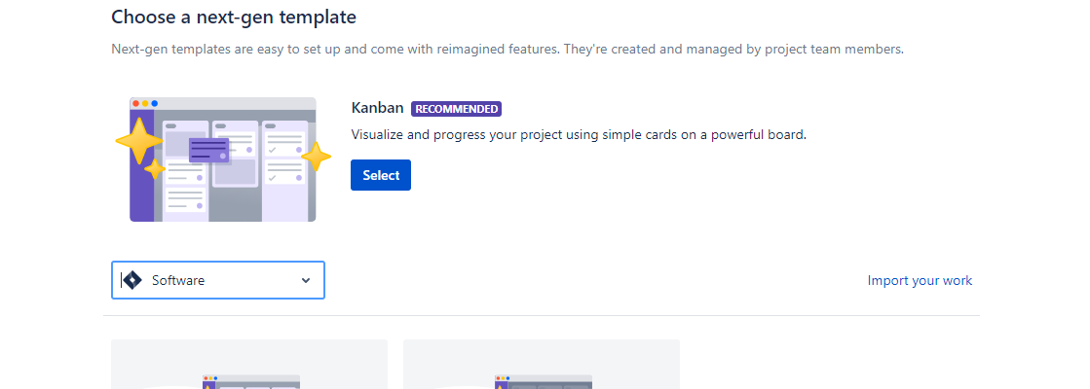
User-Story

Slide 22
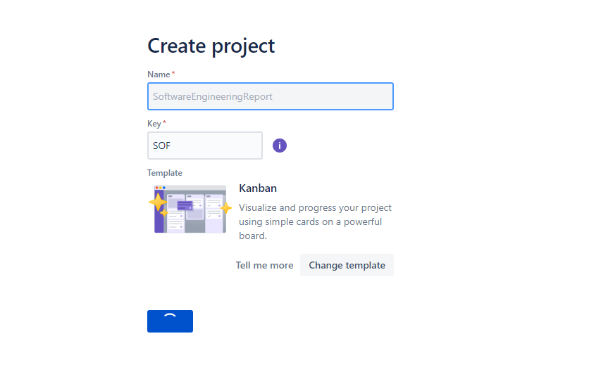
User-Story

Slide 23
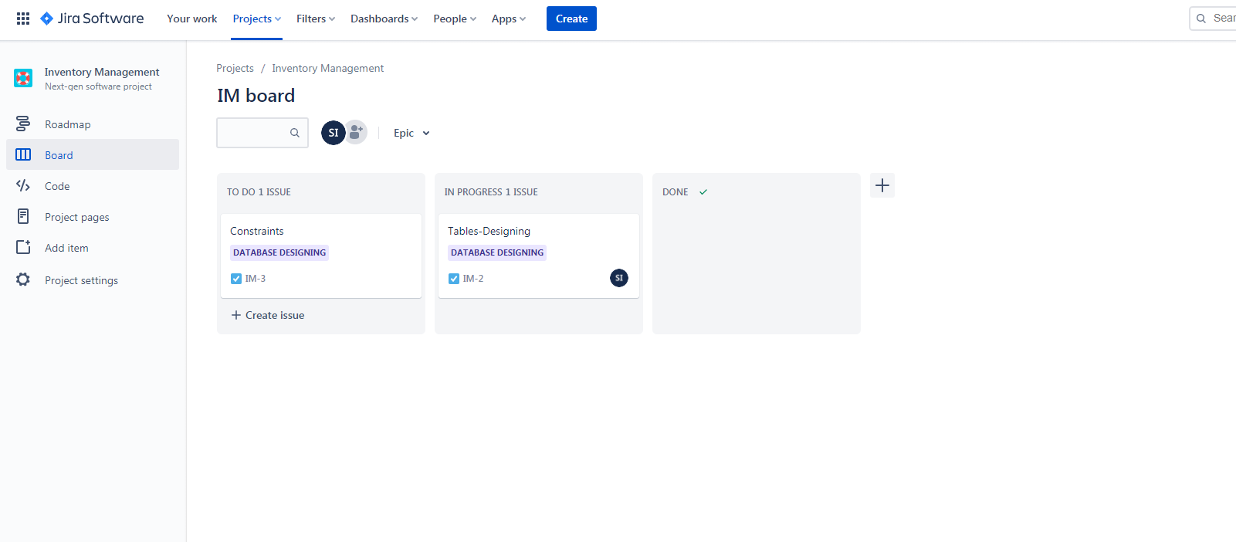
User-Story

Slide 24
Class 08 24-feb-2021

Slide 25
A ‘prescribing medication’ story

Slide 26
Examples of task cards for prescribing medication

Slide 27
Refactoring
A fundamental precept of traditional software engineering is that you should design for change.
Extreme programming, however, has discarded this principle on the basis that designing for change is often wasted effort.
changes will always have to be made to the code being developed. To make these changes easier, the developers of XP suggested that the code being developed should be constantly refactored.

Slide 28
Refactoring
Refactoring improves the software structure and readability and so avoids the structural deterioration that naturally occurs when software is changed.
class PizzaDelivery:
def getgrades(self):
return 'A' if self.moretheneight() else B
def ismorethaneight(self):
return self.number > 8
This could be refactored as:
class PizzaDelivery:
def getgrades(self):
return self.number > 8 ? A : B

Slide 29
Test-first development
Test-first development.
Incremental test development from scenarios.
User involvement in test development and validation.
Automated test harnesses are used to run all component tests each time that a new release is built.
Testing is central to XP and XP has developed an approach where the program is tested after every change has been made.
XP testing features:

Slide 30
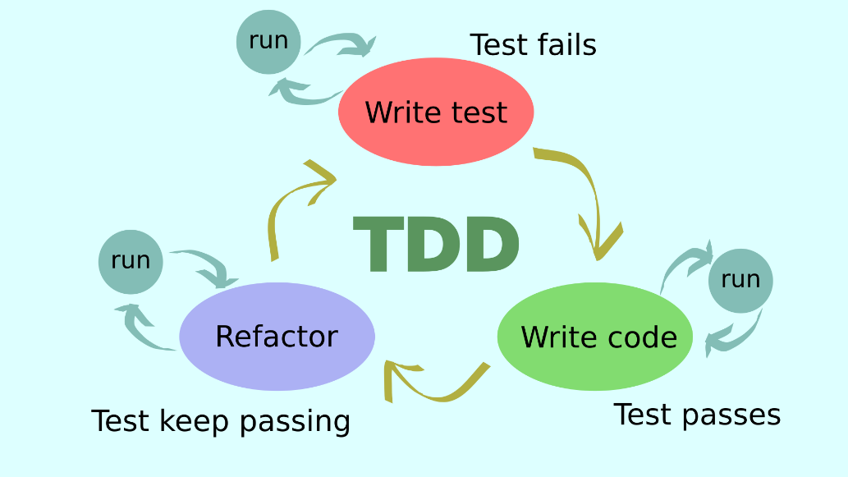
Test-driven development
Writing tests before code clarifies the requirements to be implemented.
Tests are written as programs rather than data so that they can be executed automatically. The test includes a check that it has executed correctly.
Usually relies on a testing framework such as Junit.
All previous and new tests are run automatically when new functionality is added, thus checking that the new functionality has not introduced errors.

Slide 31
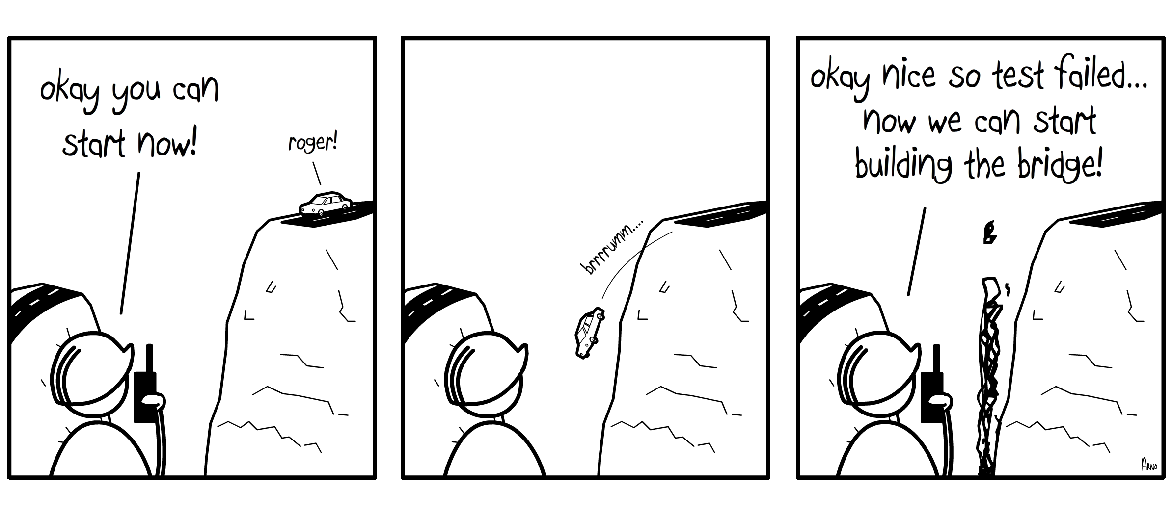
Example

Slide 32
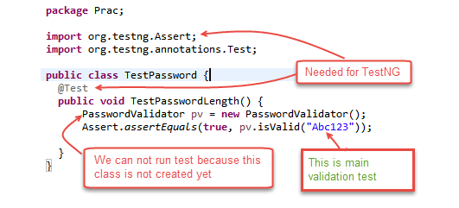
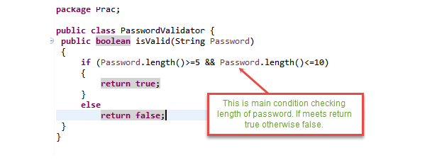
Example
we will define a class password. For this class, we will try to satisfy following conditions.
A condition for Password acceptance:
The password should be between 5 to 10 characters.
Scenario 1: To run the test, we create class PasswordValidator ();

Slide 33
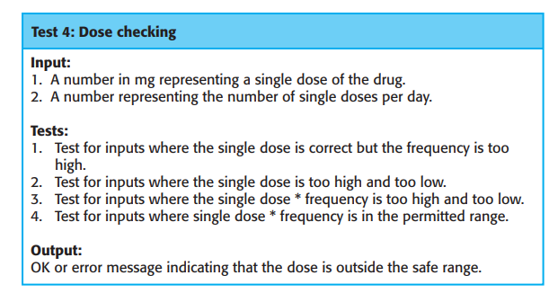
Test case description for dose checking
Example

Slide 34
Test automation
Test automation is essential for test-first development. Tests are written as executable components before the task is implemented.
These testing components should be stand-alone, should simulate the submission of input to be tested, and should check that the result meets the output specification.

Slide 35
Problems with test-first development
?

Slide 36
Class 09 26-feb-2021

Slide 37
Agile project management
Managers need to know what is going on and whether or not a project is likely to meet its objectives and deliver the software on time with the proposed budget.
A plan-based approach requires a manager to have a stable view of everything that has to be developed and the development processes.
Agile project management requires a different approach, which is adapted to incremental development and the practices used in agile methods.

Slide 38
Earlier Issues
The informal planning and project control that was proposed by the early adherents of agile methods clashed with this business requirement for visibility.
Teams were self-organizing, did not produce documentation, and planned development in very short cycles.
While this can and does work for small companies developing software products, it is inappropriate for larger companies who need to know what is going on in their organization.

Slide 39
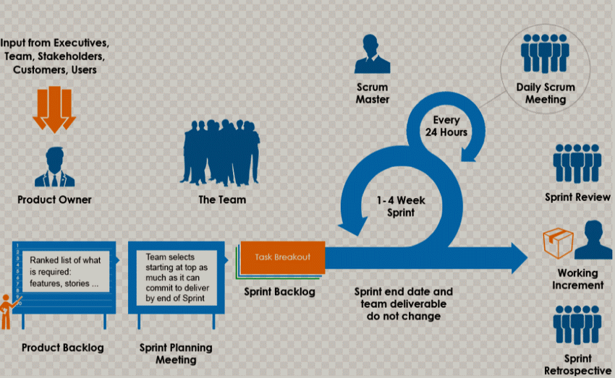
To Address this issue
(Schwaber and Beedle 2001; Rubin 2013) to provide a framework for organizing agile projects and, to some extent at least, provide external visibility of what is going on.

Slide 40
Scrum
Scrum is one of the agile methodologies /framework designed to guide teams in the iterative and incremental delivery of a product. Often referred to as “an agile project management framework
We should first be clear on what Scrum is not.
There is a common misconception that Agile is Scrum. While Scrum is indeed agile, it is not the sole method of implementing agile principles.
Scrum is simply one of many agile approaches to product development.

Slide 41
Scrum Team
Development team
Potentially shippable product increment
Product backlog
Product owner
Scrum
ScrumMaster
Sprint
A self-organizing group of software developers, which should be no more than seven people. They are responsible for developing the software and other essential project documents.
The software increment that is delivered from a sprint. The idea is that this should be “potentially shippable,” which means that it is in a finished state.
This is a list of “to do” items that the Scrum team must tackle. They may be feature definitions for the software, software requirements, user stories, or descriptions of supplementary tasks that are needed
The Product Owner can be a customer but might also be a product manager in a software company or other stakeholder representative
A daily meeting of the Scrum team that reviews progress and prioritizes work to be done that day.
The ScrumMaster is responsible for ensuring that the Scrum process is followed and guides the team in the effective use of Scrum
A development iteration. Sprints are usually 2 to 4 weeks long.
Velocity An estimate of how much product backlog effort a team can cover in a single sprint. Understanding a team’s velocity helps them estimate what can be covered in a sprint and provides a basis for measuring improving performance.

Slide 42
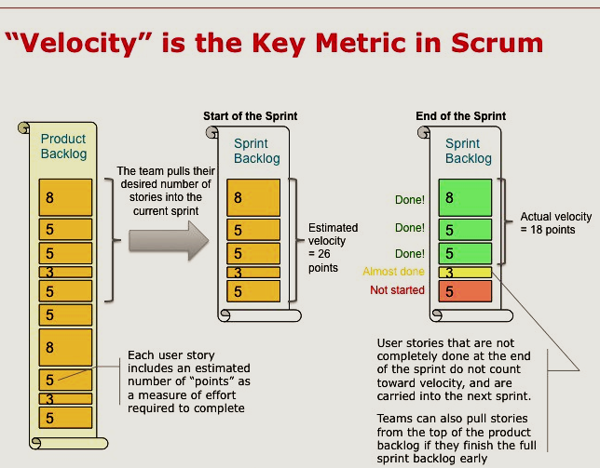
Velocity:
Velocity is a measure of the amount of work a Team can tackle during a single Sprint and is the key metric in Scrum. Velocity is calculated at the end of the Sprint by totaling the Points for all fully completed User Stories.

Slide 43
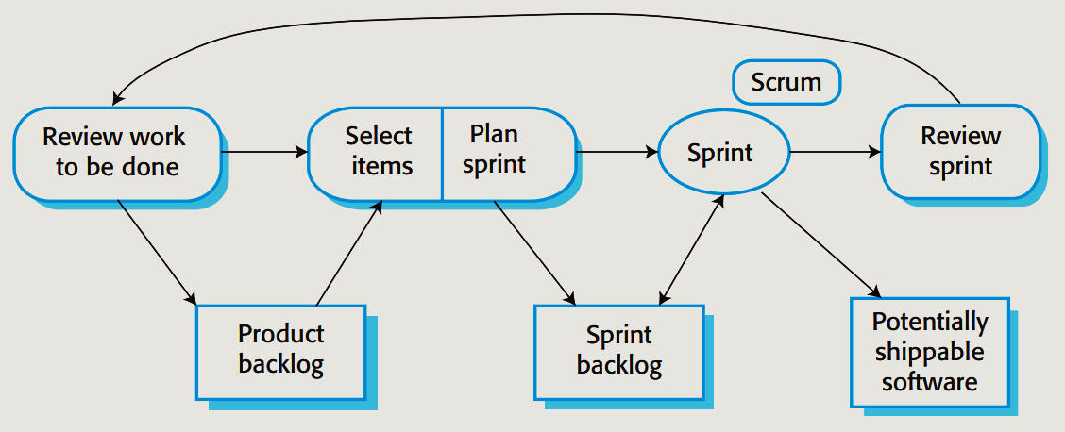
The Scrum process

Slide 44
The Scrum sprint cycle
Sprints are fixed length, normally 2–4 weeks.
The starting point for planning is the product backlog, which is the list of work to be done on the project.
The selection phase involves all of the project team who work with the customer to select the features and functionality from the product backlog to be developed during the sprint.
The daily interactions among Scrum teams may be coordinated using a Scrum board.
This is a shared resource for the whole team, and anyone can change or move items on the board. It means that any team member can, at a glance, see what others are doing and what work remains to be done.

Slide 45
Scrum benefits
The product is broken down into a set of manageable and understandable chunks.
Unstable requirements do not hold up progress.
The whole team have visibility of everything and consequently team communication is improved.
Customers see on-time delivery of increments and gain feedback on how the product works.
Trust between customers and developers is established and a positive culture is created in which everyone expects the project to succeed.

Slide 46
Distributed Scrum
Allows companies to take advantage of lower cost staff in other countries, makes access to specialist skills possible, and allows for 24-hour development, with work going on in different time zones.

Slide 47
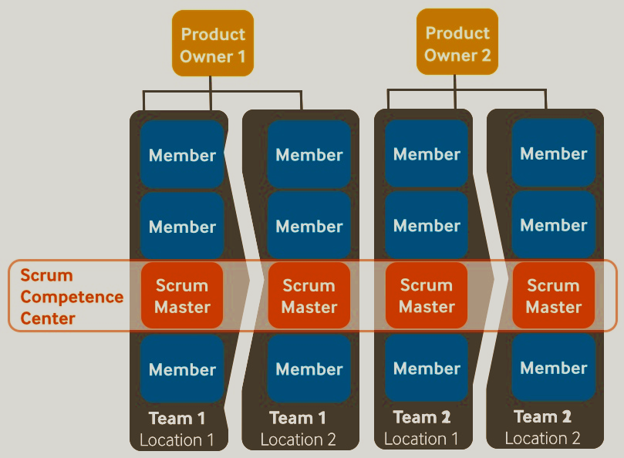
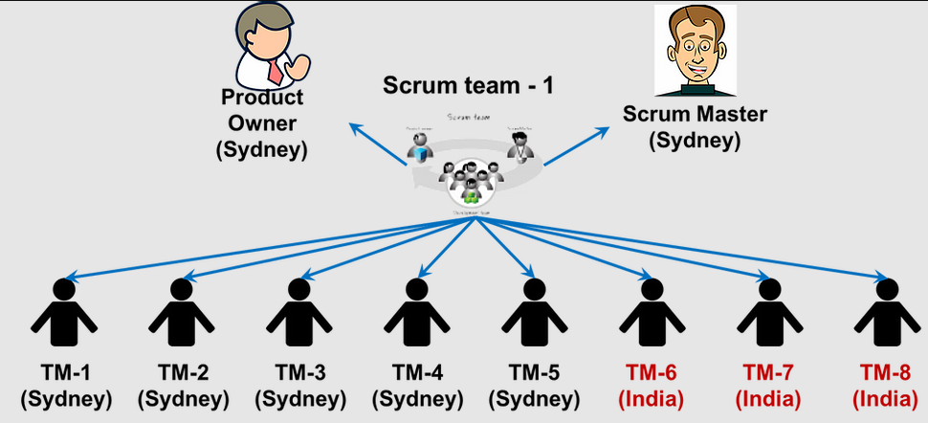
Distributed Scrum

Slide 48

Scrum vs Kanban

Slide 49
Thankyou

